Slide 1
Save the children
Presented by Mr. Rodgers & Friends: john Rodgers, David Nguyen, Austin Simeone, & Hannah Kosinovsky

Slide 2
Business objectives

Slide 3
Business objectives
Our world is becoming less poor and more healthy with every year. This is encouraging news, but we must also study potential causes for and hindrances to this phenomenon.
Question: Where should the Bill & Melinda Gates Foundation (BMGF) expand?
Hypothesis: The Bill & Melinda Gates Foundation should expand to countries with low literacy rates and low female occupation rates because those two variables correspond to low survival rates.

Slide 4
Data source

Slide 5
Where the data came from
We obtained the data from the World Bank.
The data contains statistics on all the countries in the world between 1960 and 2016.
The reason we chose this data is it included education, occupation, and gender.
There are 162 indicator variables for which stats were collected, but data was not available for every indicator variable.

Slide 6
Methodology

Slide 7
steps
We performed a linear regression to determine if there is a correlation between literacy rate and survival rate.
We performed a multiple regression on 4 variables: mother’s position maternity, female life expectancy, female participation, and female manager.

Slide 8
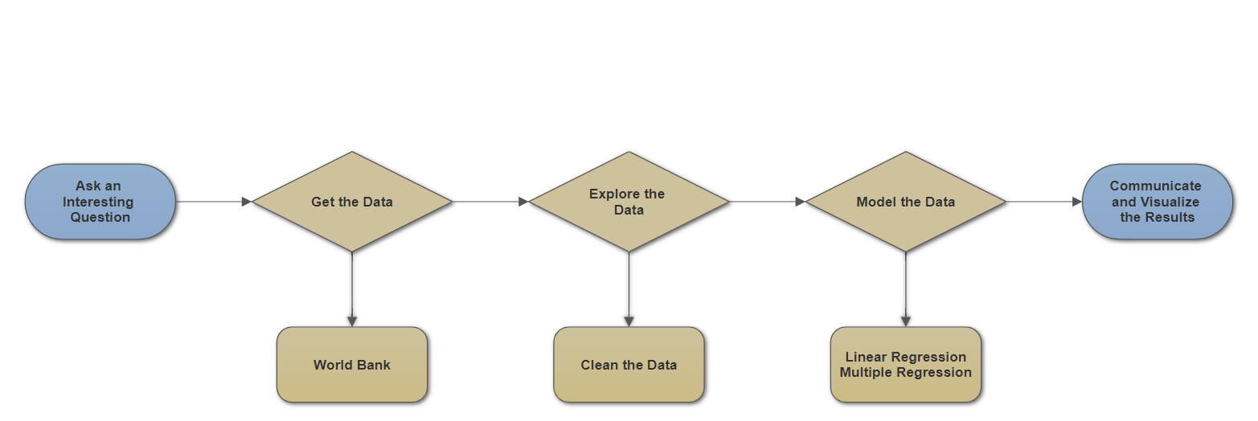
workflow

Slide 9
Evaluation/results

Slide 10
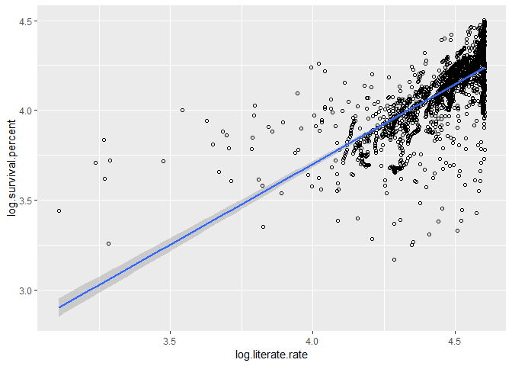
log of literate rate vs. Log of survival rate
Approximately 49.5% of the variation in the log of survival rate is explained by the log of the literate rate.
*Equation interpretation goes here.

Slide 11
Other things to consider
While our linear regression model showed ~50% correlation and our multiple regression model showed ~75% correlation, there are 162 total variables, so a stronger model and/or use of other variables may obtain higher correlation percentages.

Slide 12
summary

Slide 13
insights
Education and occupation have huge correlation to life expectancy and morality.
Therefore, the Bill & Melinda Foundation should expand and bring aid to countries with low literacy and low female occupation rates.

Slide 14
Recommendations
Since the Bill & Melinda Foundations

Slide 15
improvements

Slide 16
questions

